Slide 1
Parallel and distributed computing
Documentation
Instructor: Hadji Tejuco
Members:
Bennett Joshua m. Lajom
Roschan niuell theodore co

Slide 2
Introduction
Purpose: The purpose of this project is to simulate an elevator system that efficiently transports passengers between floors in a multi-story building. It demonstrates the use of multithreading, synchronization, and data structures in C++.

Slide 3
Objectives
Simulate an elevator system that handles multiple passengers concurrently.
Implement multithreading for simulating elevator movement and passenger requests.
Ensure proper synchronization using mutexes and condition variables.

Slide 4
Scope
The simulation includes an elevator that moves between 9 floors.
Each passenger has a start floor and a destination floor.
The elevator operates with a maximum capacity of 5 passengers.
The program stops once all passengers reach their destinations.

Slide 5

Project Overview

Slide 6

Project statement
Managing elevator operations efficiently is crucial in multi-story buildings. The challenge lies in handling multiple passenger requests, ensuring optimal movement, and preventing overcrowding. This project aims to simulate an efficient elevator system using concurrent programming techniques.

Slide 7
Key Features
Multi-threaded passenger and elevator simulation.
Synchronization using mutexes and condition variables.
Real-time logging of elevator movement and passenger activity.
Dynamic passenger handling based on user input.

Slide 8
Requirement Analysis

Slide 9
Functional requirements
Passengers should be able to enter and exit the elevator at their designated floors.
The elevator should move up and down between floors.
The system should manage passenger requests concurrently.

Slide 10
Non-Functional Requirements
The system should ensure thread safety using mutex locks.
The program should be user-friendly and provide clear logs of elevator operations.
The simulation should run efficiently without excessive CPU usage.

Slide 11
System design

Slide 12
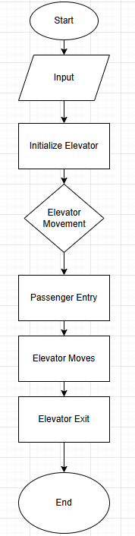
Flowchart

Slide 13
implementation

Slide 14
Technologies used
Iostream
Thread
Vector
Mutex
Condition_variable
Atomic
Chrono

Slide 15
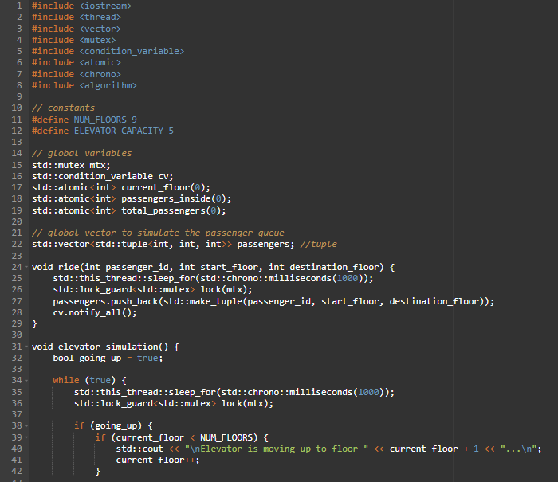
Code screenshots

Slide 16
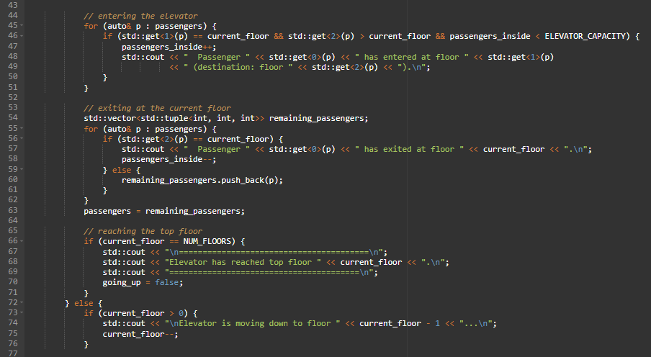
Code screenshots

Slide 17
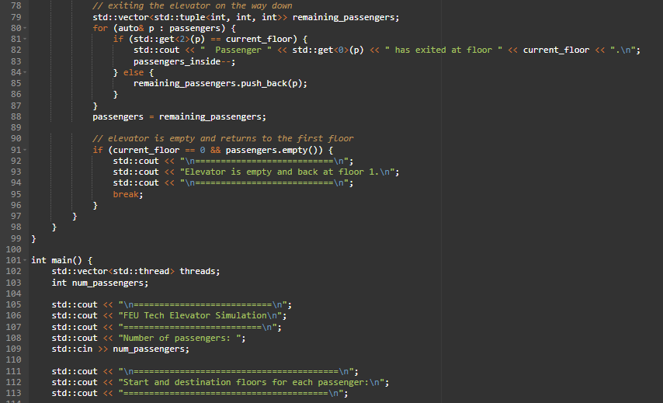
Code screenshots

Slide 18
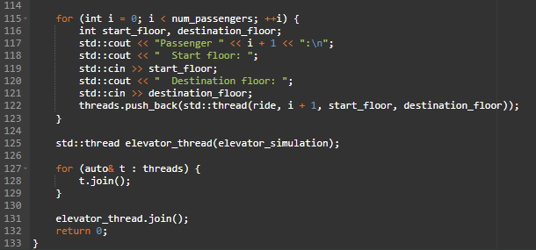
Code screenshots

Slide 19
Code structure
Passenger Handling:
Std::vector<std::tuple<int, int, int>> passengers;
It stores passenger data (ID, start floor, destination floor)
void ride (int passenger_id, int, start_floor, int destination_floor);
Simulates a passenger entering and riding the elevator.

Slide 20
Code structure
Elevator Operations:
Std::atomic<int> current_floor;
Tracks the current floor of the elevator.
std::atomic<int> passengers_inside;
Counts the number of passengers currently in the elevator
Void elevator_simulation();
Controls the elevator movement and passenger handling.

Slide 21
Code structure
Simulation Control:
Std::mutex mtx; and std::condition_variable cv;
Ensure thread synchronization.
Int main();
Initializes the simulation, manages passenger input, and starts threads.

Slide 22
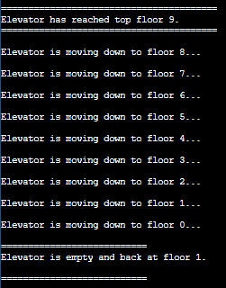
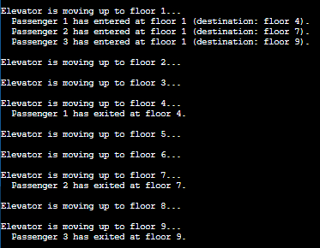
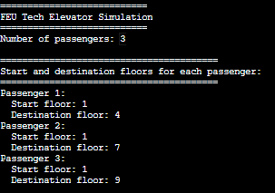
testing

Slide 23
User manual
Using the git hub repo link, it’ll already direct the user to the main branch, by clicking the “Group5” it’ll show our whole code. Copy and Paste it to Dev C++ or OnlineGDB (C++) Compiler, For DevC++, compiler option TDM-GCC 10.3.0 and Language standard (-std) must be GNU C++11 selected. Now the user can compile and run the program, For the user input it’ll ask for how many passengers are there, after entering how many passengers, now it’ll ask what floor (1-9) are they from and the destination, once both have been entered, The Elevator will now go to their designated floors.

Slide 24
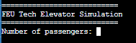
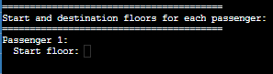
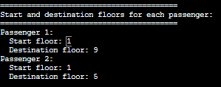
User manual
Once the code has been started, it’ll ask the user how many passengers are there
After the elevator knowing how many passengers are there, it’ll now ask for each passenger where they want to be picked up and dropped off

Slide 25
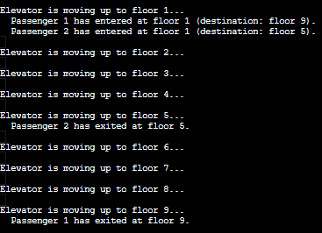
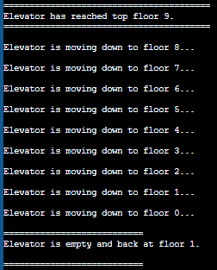
User manual
After the user input, it’ll start heading up or down to their designated floors
Once the elevator dropped off all the passengers in the elevator and reached at the top (floor 9)
It’ll now head down once again

Slide 26
Challenges & solutions
Challenges Faced
We’ve had a big problem about passengers going out at the right floors, Up and down, we had problems that our elevator can’t drop passengers that are going down or up
Solutions
We used mutexes to prevent concurrent data modification.
Implemented condition variables to manage thread communication.

Slide 27
Future Enhancements
Potential Improvements
Implement a graphical user interface (GUI) for better visualization.
Optimize elevator movement using an improved scheduling algorithm.
Add real-world constraints like emergency stops or maintenance mode.

Slide 28

Findings and evaluation

Slide 31
Comments and suggestion
Group 4
“Job well done”
Group 6
“Good Work!”
Group 2, 8, 10, 12, 14, 16, 18, & 20 “None.”

Slide 32
Conclusion
The Elevator Simulation effectively illustrates the application of C++ concurrent programming, synchronization, and multithreading. The app automatically handles several passengers and floor requests, accurately simulating real-world elevator operations. The implementation was improved to increase overall efficiency in spite of some early difficulties with synchronization and controlling downward movements.

Slide 33
References
C++ Standard Library documentation
Multithreading in C++ (Online Resources)

Slide 34
Appendix b:
#include <iostream>
#include <thread>
#include <vector>
#include <mutex>
#include <condition_variable>
#include <atomic>
#include <chrono>
#include <algorithm>
// constants
#define NUM_FLOORS 9
#define ELEVATOR_CAPACITY 5
// global variables
std::mutex mtx;
std::condition_variable cv;
std::atomic<int> current_floor(0);
std::atomic<int> passengers_inside(0);
std::atomic<int> total_passengers(0);
// global vector to simulate the passenger queue
std::vector<std::tuple<int, int, int>> passengers; //tuple
void ride(int passenger_id, int start_floor, int destination_floor) {
std::this_thread::sleep_for(std::chrono::milliseconds(1000));
std::lock_guard<std::mutex> lock(mtx);
passengers.push_back(std::make_tuple(passenger_id, start_floor, destination_floor));
cv.notify_all();
}
void elevator_simulation() {
bool going_up = true;
while (true) {
std::this_thread::sleep_for(std::chrono::milliseconds(1000));
std::lock_guard<std::mutex> lock(mtx);

Slide 35
if (going_up) {
if (current_floor < NUM_FLOORS) {
std::cout << "\nElevator is moving up to floor " << current_floor + 1 << "...\n";
current_floor++;
}
// entering the elevator
for (auto& p : passengers) {
if (std::get<1>(p) == current_floor && std::get<2>(p) > current_floor && passengers_inside < ELEVATOR_CAPACITY) {
passengers_inside++;
std::cout << " Passenger " << std::get<0>(p) << " has entered at floor " << std::get<1>(p)
<< " (destination: floor " << std::get<2>(p) << ").\n";
}
}
// exiting at the current floor
std::vector<std::tuple<int, int, int>> remaining_passengers;
for (auto& p : passengers) {
if (std::get<2>(p) == current_floor) {
std::cout << " Passenger " << std::get<0>(p) << " has exited at floor " << current_floor << ".\n";
passengers_inside--;
} else {
remaining_passengers.push_back(p);
}
}
passengers = remaining_passengers;
// reaching the top floor
if (current_floor == NUM_FLOORS) {
std::cout << "\n========================================\n";
std::cout << "Elevator has reached top floor " << current_floor << ".\n";
std::cout << "========================================\n";
going_up = false;
}
} else {
if (current_floor > 0) {
std::cout << "\nElevator is moving down to floor " << current_floor - 1 << "...\n";
current_floor--;
}

Slide 36
// exiting the elevator on the way down
std::vector<std::tuple<int, int, int>> remaining_passengers;
for (auto& p : passengers) {
if (std::get<2>(p) == current_floor) {
std::cout << " Passenger " << std::get<0>(p) << " has exited at floor " << current_floor << ".\n";
passengers_inside--;
} else {
remaining_passengers.push_back(p);
}
}
passengers = remaining_passengers;
// elevator is empty and returns to the first floor
if (current_floor == 0 && passengers.empty()) {
std::cout << "\n===========================\n";
std::cout << "Elevator is empty and back at floor 1.\n";
std::cout << "\n===========================\n";
break;
}
}
}
}

Slide 37
int main() {
std::vector<std::thread> threads;
int num_passengers;
std::cout << "\n===========================\n";
std::cout << "FEU Tech Elevator Simulation\n";
std::cout << "===========================\n";
std::cout << "Number of passengers: ";
std::cin >> num_passengers;
std::cout << "\n========================================\n";
std::cout << "Start and destination floors for each passenger:\n";
std::cout << "========================================\n";
for (int i = 0; i < num_passengers; ++i) {
int start_floor, destination_floor;
std::cout << "Passenger " << i + 1 << ":\n";
std::cout << " Start floor: ";
std::cin >> start_floor;
std::cout << " Destination floor: ";
std::cin >> destination_floor;
threads.push_back(std::thread(ride, i + 1, start_floor, destination_floor));
}
std::thread elevator_thread(elevator_simulation);
for (auto& t : threads) {
t.join();
}
elevator_thread.join();
return 0;
}

Slide 38
Thank you!

